Slide 1

SPOTLIGHT: MALAYSIA

Slide 2

We are bringing our campaign to Malaysia due to the exponential increase of young drug mules from the country:
The majority of drug mules arrested in Hong Kong International Airport typically arrived from Africa and South America, but in 2018 the number of Malaysians was greater than the total of Africans and South Americans combined

Slide 3
475% increase
In 2018 there were 23 young Malaysians arrested at Hong Kong International Airport for drug trafficking compared to only four arrested for the same offence in 2017

Slide 4
Average prison sentence length* in Hong Kong for drug trafficking
All 23 were found trafficking dangerous drugs, and each face about 10 years of prison – that’s 230 years wasted in Hong Kong prisons!
*Based on historical data

Slide 5
700g heroin
The youngest arrested was a 16-year-old female student visiting Hong Kong in March, who concealed 700g of heroin with a street value of HK$1.05 million. She arrived at Hong Kong International Airport from Kuala Lumpur alongside a 19-year-old man
=
HK$1.05
million

Slide 6
Smuggling syndicates prey on teenagers and young adults to do their dirty work by offering them
free overseas trips, entertainment, or cash to carry goods

Slide 7

Kuala Lumpur Airport security is lax.
One recent young mule to Hong Kong had 6kg of Ice and 3kg of cocaine in his checked-in luggage. No problem going through KLIA!

Slide 8

Drug trafficking in Hong Kong is a serious offence and carries a maximum penalty of life imprisonment and a HK$5 million fine

Slide 9
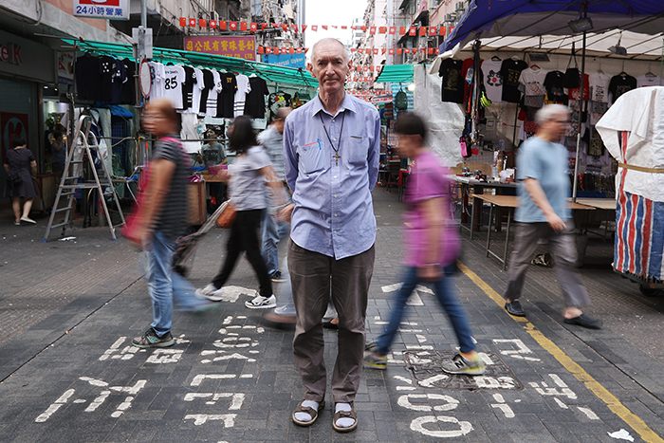
ABOUT US
No More Mules warns vulnerable persons duped into becoming drug mules
Our campaign’s mission is to raise awareness of the dangers of trafficking drugs into Hong Kong and its extremely long and punitive prison sentences. By sharing prisoners’ letters, we help to spread the message and inspire change within the prisoners’ countries of origin.
The campaign is lead by Hong Kong prison chaplain Father John Wotherspoon.
Since 2013, Father John’s anti-drug campaign has greatly reduced the number of drug mules entering Hong Kong from Africa and South America.

Slide 10
USEFUL RESOURCES
Drug smuggling Hong Kong news
Hong Kong’s young smugglers told: get caught and your age won’t save you from decades in jail
Hong Kong dishes out severe punishment for drug mules while gang leaders remain free
Published true stories for the campaign
From KL To HK With Complimentary Flight Tickets To Jail
Looking For Extra Cash For The New Year, Malaysian Chef Turns Drug Mule
Jailed At 18 – Young Malaysian In Hong Kong Prison
Press about the campaign
The prison chaplain who has stopped 150 drug mules reaching Hong Kong
Hong Kong priest’s mission to save drug mules from a system that favours kingpins
Videos about the campaign
https://youtu.be/pGuQyMhfbmA
https://youtu.be/qr9D6L67fTQ
https://youtu.be/rVcqHWfIv2s

Slide 11
CONTACT
JOHN WOTHERSPOON
Whatsapp: +852 6709 5674
Email: jdwomi@gmail.com
/nomoremules
nomasmulas.com/category/english/

